Slide 1
Stack In Assembly Language
Pass Parameters to Subroutines
Local Variables

Slide 2
Pass parameters to Subroutines
If we have to pass limited data to subroutines, we can pass using registers.
Register operations are inherently faster than memory operations.
But
We have limited # of registers.
If send some data into 4 registers to one subroutine then what would we do in the next subroutine.
When we are moving from one subroutine to another then at maximum we can send 7 parameters.

Slide 3
Pass parameters to Subroutines
We can use push and pop of stack to pass parameters via Stack.
In bubble sort,
First parameter was the address of the array
Second parameter was the count of number of elements in the array.
We can pass these parameters via Stack.
Can’t we send this information to the subroutine via Stack?
We can!!!

Slide 4
Pass parameters to Subroutines
Place the information on the Stack.
Whenever we Call the subroutine, we know exactly that
2 bytes of Top of the Stack is the return address
2 bytes below is the address of the array
2 bytes is the count of the number of elements of the array.
So, we can pass on information to subroutine.
Now, the next question is that how we can read this information?
How can we access this information in the subroutine?
The first thing that comes in mind is to use “Pop”.
Pop information from Stack to register and then use from register.

Slide 5
Pass parameters to Subroutines
But this is not the noble way to do this.
You have to remember few things
First, which data is present on top of the Stack
Last in First Address.
If I have pushed the parameter first on to Stack and then Call Subroutine.
Now on top of the stack is the return address and then below that our parameter is suppressed.
How can we access our parameter in subroutine using POP?
Pop now will give us the return address as it is present on Top of Stack.

Slide 6
Pass parameters to Subroutines
Let’s suppose a heavy rock has fallen down on a person’s leg.
How we’ll push out the leg of the person now?
The better strategy is to
First take off the heavy rock from leg
Then push leg
Same as Stack!!!
Same in our situation of subroutine, If we want to access parameter then first we have to take off return address in some register and then we can take out the parameter – which is not a better strategy as we have to access our return address from register at the end of subroutine by pushing it again on Stack and use ret.

Slide 7
Pass parameters to Subroutines
We have discussed different segment and pointer registers with their default segments.
Default segment of bp is ss.
We can use this bp to access parameters present in Stack without using POP or without removing those parameters from Stack.
BP keeps offset of SS.
We can perform any operation on SS using BP without using SP.
SP is dynamic operator – It changes its value sometimes without telling us.
4 registers are used to access memory:
BX, SI, DI, BP
SP is not present in them. We cannot use SP as pointer in memory in any add or move. SP is pointer in memory but It is automatic pointer in memory, It is not optional pointer in memory. We can use this pointer in the form of PUSH, POP, CALL, RET,… SP is an automatic parameter, It has no role as generic parameter and It’s not either legal.

Slide 8
Pass parameters to Subroutines – Point BP
We can use BP to access parameter from Stack without using POP.
We would not change the structure of the Stack.
Now, we’ll see how can we give value to BP in Stack.
MOV ax, 3
PUSH AX
MOV AX,4
PUSH AX
CALL subr
We have one reference point to check where our parameters are in Stack. That reference point is value of SP.
IF Mov BP, SP
Then BP+0 = Return Address
BP+2=Second Parameter i.e. 4
BP+4=First Parameter i.e. 3
Because default segment of both BP and SP is Stack Segment.
So, both points to same memory location.
Stack
Return address
4
3

Slide 9
Pass parameters to Subroutines – Point BP
We can use BP to access parameter from Stack without using POP.
We would not change the structure of the Stack.
Now, we’ll see how can we give value to BP in Stack.
MOV ax, 3
PUSH AX
MOV AX,4
PUSH AX
CALL subr
We have one reference point to check where our parameters are in Stack. That reference point is value of SP.
Decrementing Stack. So, +2 gives the value below. The values in the lower section of Stack (inserted first) have the higher address.
Stack
Return address
4
3

Slide 10
Pass parameters to Subroutines – Point BP
We can use BP to access parameter from Stack without using POP.
We would not change the structure of the Stack.
Now, we’ll see how can we give value to BP in Stack.
MOV ax, 3
PUSH AX
MOV AX,4
PUSH AX
CALL subr
We have one reference point to check where our parameters are in Stack. That reference point is value of SP.
We don’t need to keep track of SP. We have set BP to our data point.
Stack
Return address
4
3

Slide 11
Pass parameters to Subroutines – Keep track of BP
If change value of BP in one subroutine and then move to other subroutine, then value of BP which was in the previous subroutine would be discarded.
We have to keep track of value of BP as well.
Idea: Before using value of any register, we should first save it.
General Rule / Standard Rule: First of all, save value of BP. PUSH BP.
Value of BP is pushed to Stack, Then
Mov BP, SP
References has changed. Now BP+0 contains the previous value of BP
BP+2 contains Return address in case of a intra segment call.
Inter segment push 4 bytes, 2 words -> CS and IP
Intra segment push 2 bytes, 1 word -> IP

Slide 12
Pass parameters to Subroutines – Keep track of BP
If change value of BP in one subroutine and then move to other subroutine, then value of BP which was in the previous subroutine would be discarded.
We have to keep track of value of BP as well.
Idea: Before using value of any register, we should first save it.
General Rule / Standard Rule: First of all, save value of BP. PUSH BP.
Value of BP is pushed to Stack, Then
Mov BP, SP
References has changed. Now BP+0 contains the previous value of BP
BP+2 contains Return address in case of a intra segment call.
Inter segment push 4 bytes, 2 words -> CS and IP
Intra segment push 2 bytes, 1 word -> IP

Slide 13
Pass parameters to Subroutines – Keep track of BP
References has changed. Now BP+0 contains the previous value of BP
BP+2 contains Return address in case of a intra segment call.
BP+4 contains Second Parameter.
BP+6 contains First Parameter.
Example: Bubble Sort
We’ll see how we’ll pass parameters. We wouldn’t use registers.
How we’ll access parameters in Bubble Sort.

Slide 14
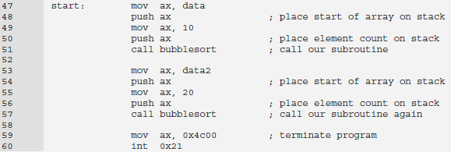
Pass parameters to Subroutines
Stack
Return address
Count of array elements
Base address of array

Slide 15
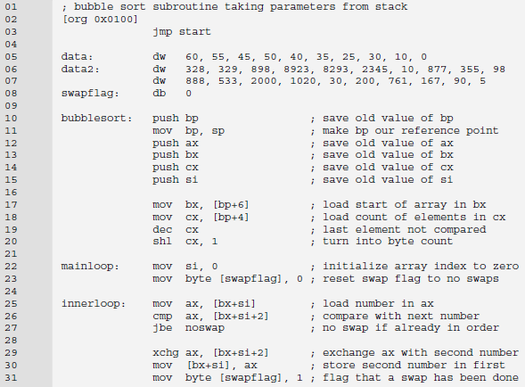
Pass parameters to Subroutines
Stack
Old value of BP, BP+0 points here
Return address
Count of array elements
Base address of array
Stack
value of si
Value of cx
Value o bx
Value of ax
Old value of BP, BP+0 points here
Return address
Count of array elements
Base address of array

Slide 16
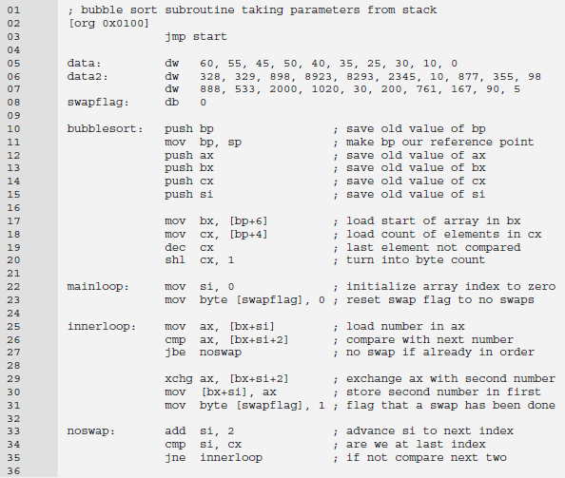
Pass parameters to Subroutines

Slide 17
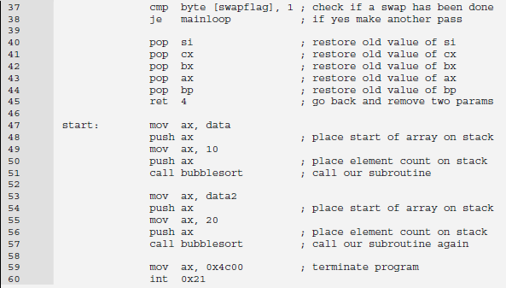
Pass parameters to Subroutines
Stack
Return address
Count of array elements
Base address of array

Slide 18
Pass parameters to Subroutines
Ret n
n would be added to stack pointer after popping the return address.
Example
Before Ret 4
SP = FFF8
After Ret 4
SP = FFFE
Ret has first popped out the return address.
Place that return address in IP.
After that added n to SP. Which in our case is that value of SP which was before the PUSH of Parameters on to Stack i.e. FFFE

Slide 19
Pass parameters to Subroutines
We PUSH parameters to Stack
Then move to subroutine and perform any operation.
Then return from subroutine
Now parameters we have passed to subroutine are useless.
So, we have to clear the stack now.
The general issue here is that operation to clear Stack is the responsibility of the caller or the callee.
Generally, more often the procedure or callee clears the Stack.
The reason is that if the Caller clears the Stack then we have to write the stack clearance code again and again whenever we call the subroutine.

Slide 20
Pass parameters to Subroutines
This method is not efficient in terms of code density.
So, the Callee should clear the stack. Now clearance code have only one copy even though call multiple times. This is code efficient.
If we don’t have Ret n instruction, then Callee can’t clear the Stack.
Callee have to perform many operations to clear the stack if don’t have any Ret n
First pop the return address.
Clear all parameters from Stack
Push again the return address.
Then ret
Callee should clear the stack. We have kept those parameter only for that subroutine. Now when the subroutine has used those parameters; we don’t need those parameters.
If we don’t clear the Stack, then Stack would go on to rise and touch the top of its Segment.

Slide 21
Pass parameters to Subroutines
On touch of top of segment,
Wraparound would occur
System would enter unstable state.
This is known as Stack Overflow.
So, clearance of Stack is necessary otherwise Stack would build up.
Efficient method is that subroutine should clear the Stack.
Using Ret n, we have discarded the parameters which are no longer in use by subroutine.

Slide 22
Local Variables
We need those variables temporarily.
No permanent space.
After subroutine, automatically wipes out.
We build these types of variables dynamically on Stack.
After completion of routine, we discard these variables.
Reusability of Space.
We produce Gap in Stack and use that Gap for temporary variables.

Slide 23
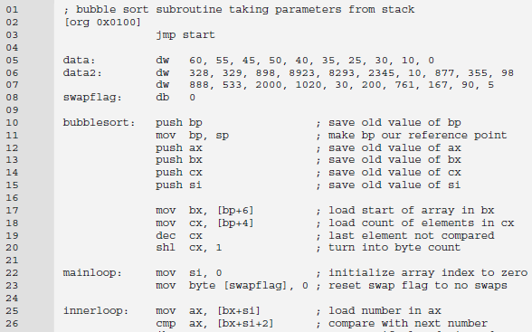
Local Variables
Local Variable???
We have permanently stored this. But needed only in Bubble Sort

Slide 24
Local Variables
We should create gap using bp
Use that gap for local/temporary/automatic variable.
Can push all other data above this gap.
When we move to subroutine, we’ll move stack pointer up to create gap. How much? How many space needed by us.
Remember we cannot create byte variable on Stack; we can create word variable.
For byte variable, we also have to create word space.
Odd address is not legal for SP.
Example: We need only one word local variable.

Slide 25
Local Variables
. . .
xx | xx
xx | xx
. . .
. . .
xx | xx
xx | xx
xx | xx
. . .
Push bp
Mov bp, sp
SP-
bp
SP-
return address
return address
parameters
parameters

Slide 26
Local Variables
. . .
xx | xx
xx | xx
xx | xx
. . .
. . .
xx | xx
xx | xx
xx | xx
. . .
Push bp
Mov bp, sp
Sub sp,2
SP-
local variables
SP-
bp
bp
return address
return address
parameters
parameters

Slide 27
Local Variables
. . .
xx | xx
xx | xx
xx | xx
. . .
. . .
xx | xx
xx | xx
xx | xx
xx | xx
xx | xx
. . .
Push bp
Mov bp, sp
Sub sp,2
Push ax
Push bx
SP-
register copies
SP-
local variables
local variables
bp
bp
return address
return address
parameters
parameters
Offset of local Variable is BP-2

Slide 28

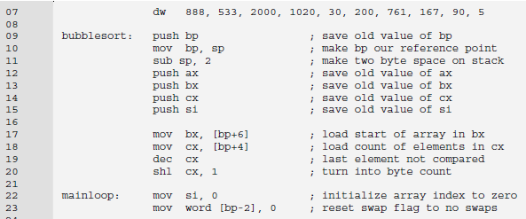
Local Variables

Slide 29
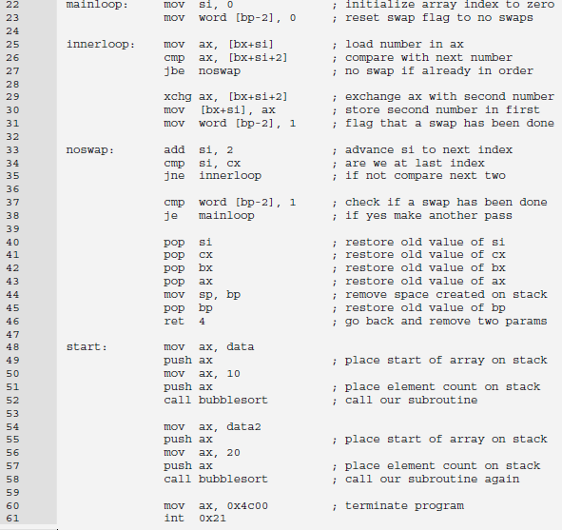
Local Variables

